Slide 1

MACHINE LEARNING ACCELERATOR
Graph Machine Learning – Lecture 3
Notes:
Welcome to Machine Learning Accelerator – the Graph Machine Learning course
Lecture 3

Slide 2
Course Overview
Lecture 1
Lecture 2
Lecture 3
Day 2:
Intro to Graph Theory & Network Analysis
Intro to ML
ML Application on Real World Graphs
DGL at a Glance
Day 2:
Learning on Graphs
Deep Walk
Graph Neural Networks (GNNs)
Graph Convolution Networks (GCNs)
GCNs with DGL
Day 2:
Advanced GNN architectures
Learning on large graphs
Heterogenous Graphs
Case Study : Recommender System with GCNs
AMA

Slide 3
Graph Neural Networks
Notes:
We’ll talk about different GNN architectures proposed in recent years and also try to compare each one of them in the following sections.

Slide 4
Setup
Given a graph G
V is the vertex set
A is the adjacency matrix
X is the set of node features
Candidates for Node Features
Social Networks : Embedding of user profile, user image etc.
Biological Networks : Gene expression profiles
No Features
One hot encoding of a node
Constant / Random initialization (if nothing is available)
Notes:
For random init, we train the network + the embeddings (random inits

Slide 5
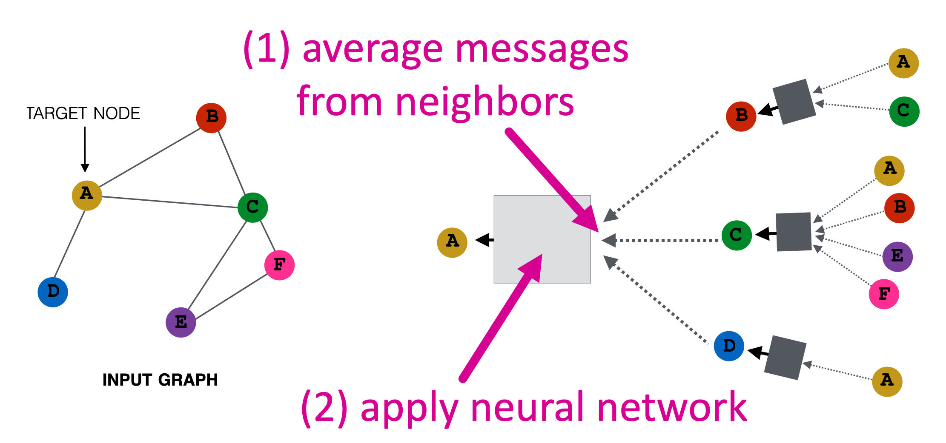
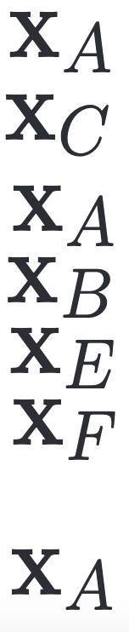
Recap
+ B₁h_{B} ⁰
h_{B}
+ B₁h_{C} ⁰
h_{C}
h_{D}
+ B₁h_{D} ⁰

Slide 6
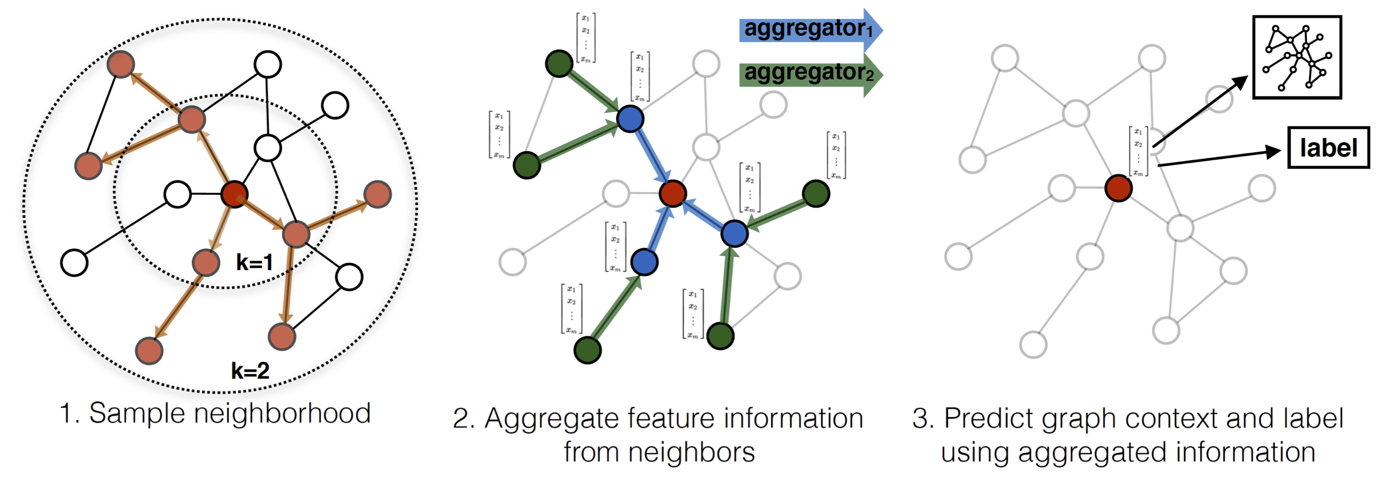
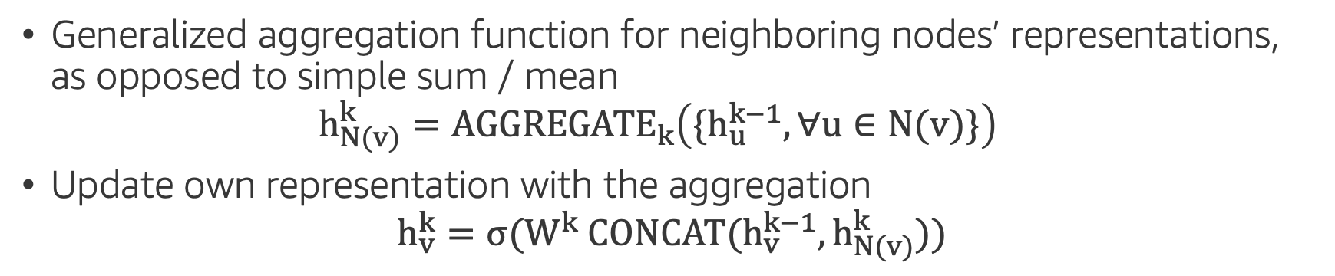
Generalizing Aggregations : GraphSAGE
Generalized aggregation function for neighboring nodes’ representations, as opposed to simple sum / mean $h_{N(v)}^{k}={AGGREGATE}_{k}\left({\{h}_{u}^{k−1}, ∀u∈N(v)\}\right)$
Update own representation with the aggregation $h_{v}^{k}=σ(W^{k} CONCAT(h_{v}^{k−1},h_{N(v)}^{k}))$
COMPUTER
SCIENCE
GraphSAGE: Inductive Representation learning on large graphs
http://snap.stanford.edu/graphsage/

Slide 7
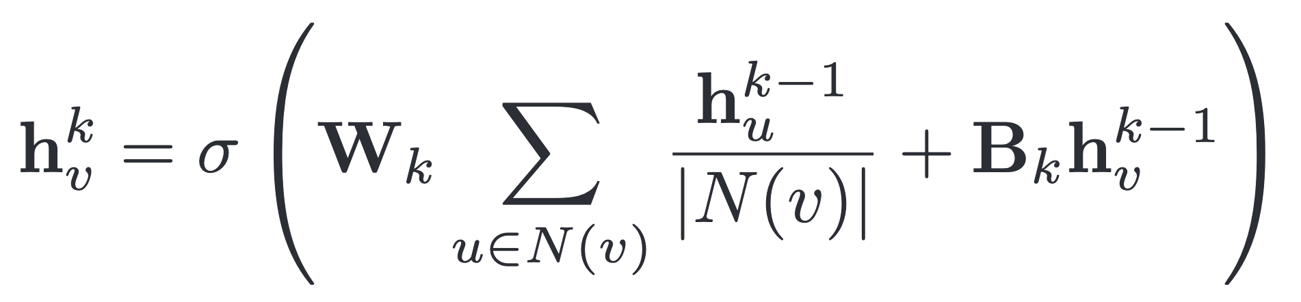
Graph Attention Networks (GAT) : Motivation
Recap : Previously, we aggregated messages across neighborhood of node using simple averaging
Every node is equally important i.e. weight = ⍺_{vu} = 1 / N(v)
How can we generalize this so that different nodes can have different importance?

Slide 8
Graph Attention Networks (GAT)
Option 1 : If the network already has edge weights, use those to create a weighted average when aggregating
Option 2 : Learn the weighting factor ⍺_{vu} implicitly using an attention mechanism a

Slide 9
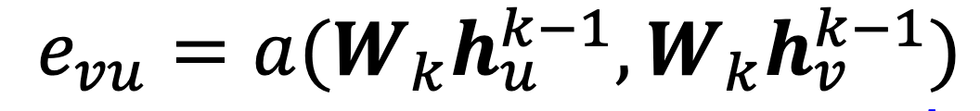
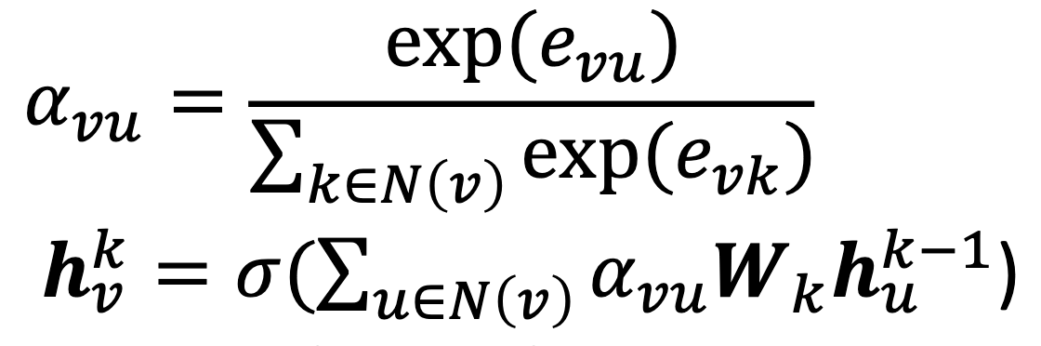
GAT : Implicit Attention Mechanism
The attention mechanism a computes attention coefficients e_{vu} across pairs of nodes u & v
To make the coefficients comparable comparable across neighborhoods, normalize with softmax

Slide 10
GAT : Implementing Attention
What functional forms can the attention mechanism a take?
Most popular option : Use a single layer neural network
Parameters of a are trained jointly end-to-end with W_{k} using backprop

Slide 11
GAT : Properties
Learn different importance values for different neighbors
Trivially localized
Increase inductive capability : attention is a shared edge-wise mechanism, not a global graph structure

Slide 12
What kind of GNN should you use?
Overall all the GNN architectures are built on top of Message Passing and have very small iterative changes in their architectures.
In practice, based on the task and the application we may prefer to choose one particular architecture over the other.
Notes:
The main novelty of GraphSAGE is a neighborhood sampling step (but this is independent of whether these models are used inductively or transductively). You can think of GraphSAGE as GCN with subsampled neighbors. In practice, both can be used inductively and transductively. The title of the GraphSAGE paper ("Inductive representation learning") is unfortunately a bit misleading in that regard. The main benefit of the sampling step of GraphSAGE is scalability (but at the cost of higher variance gradients).

Slide 13
What kind of GNN should you use?
GCN : Simple GNN model with self loops, normalization and shared parameters.
GraphSAGE : The concatenation step to update nodes representation helps preserve the node information and aims to mitigate oversmoothing problem in GNNs to some extent.
GAT : Attention increases the representational capacity of a GNN model, especially where we have prior knowledge to indicate that some neighbours might be more informative than others.
COMPUTER
SCIENCE

Slide 14
Learning on Large Graphs

Slide 15
Real World Graphs are Gigantic
Application graphs can be extremely large – with millions of nodes and billions of edges:
Social networks
Recommendation
Knowledge graph
…
MATHEMATICS

Slide 16
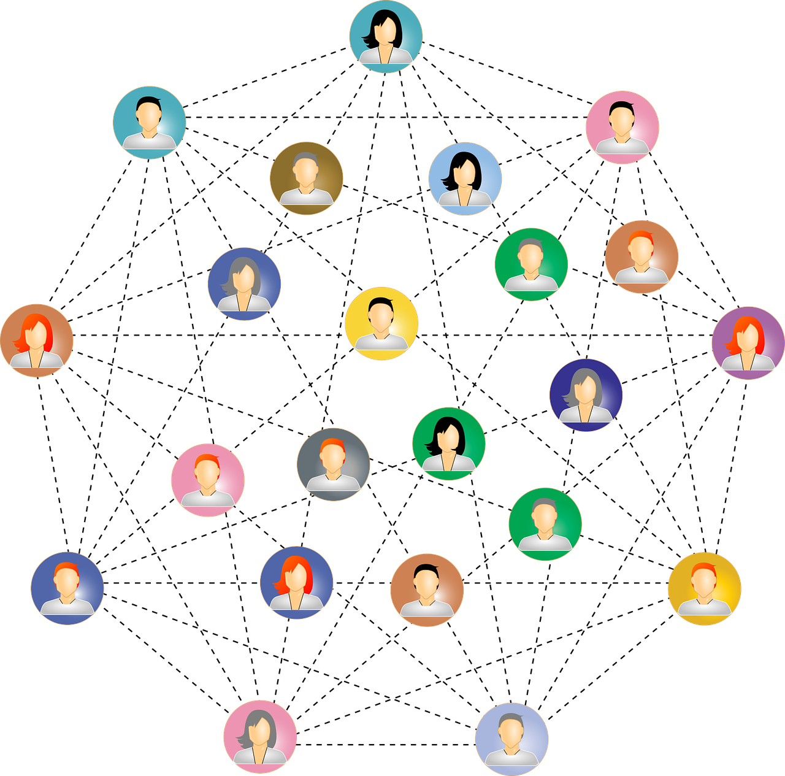
Real World Graphs are Gigantic
MATHEMATICS
users
products
Social network
Knowledge graph
Recommendation
|V|: 100M – 1B
|V|: 1M – 100M
|V|: 1M – 1B

Slide 17
Full Graph Training
Use the whole graph to run the forward and backward pass
Memory consumption for a generic GNN model is proportional to |V| and |E|
A graph with 1B edges may require terabytes of memory

Slide 18
Mini-batch Training
MATHEMATICS
Full Dataset

Slide 19
Mini-batch Training
ML model
Batching
Data points are independent and identically distributed (IID).
Full Dataset

Slide 20

How to apply mini-batch training to graphs?
Nodes (data points) in graphs have edges (dependencies)
MATHEMATICS

Slide 21
Two-layer GNN : A Node Perspective
Compute the embedding of node 1 of layer 2
2
3
1
10
5
9
4
6
8
7
11

Slide 22
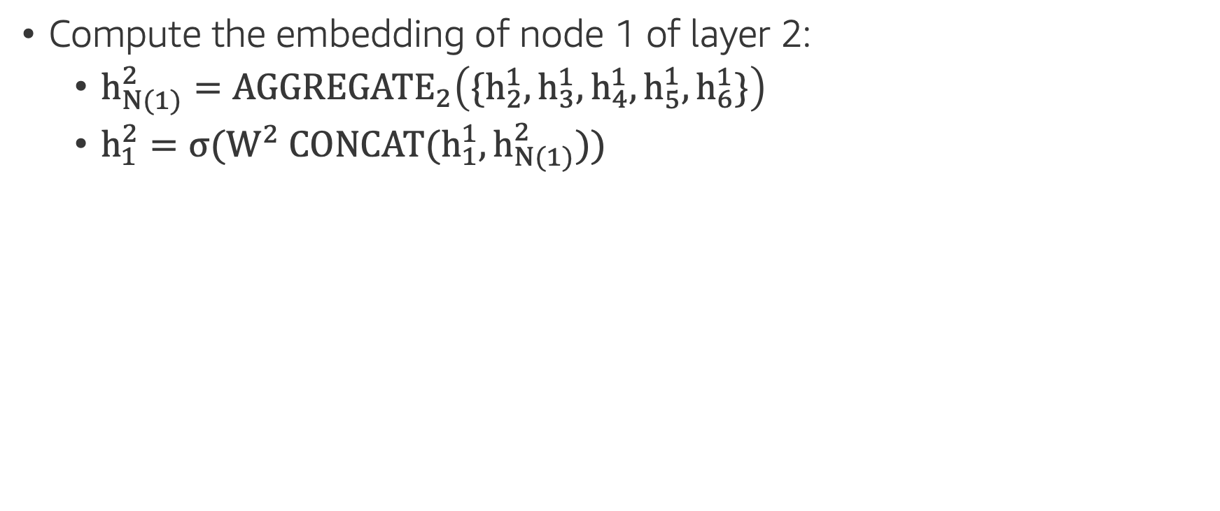
Two-layer GNN : A Node Perspective
Compute the embedding of node 1 of layer 2:
$h_{N(1)}^{2}={AGGREGATE}_{2}\left(\{h_{2}^{1},h_{3}^{1},h_{4}^{1},h_{5}^{1},h_{6}^{1}\}\right)$
$h_{1}^{2}=σ(W^{2} CONCAT(h_{1}^{1},h_{N(1)}^{2}))$
2
3
1
10
5
9
4
6
8
7
11

Slide 23
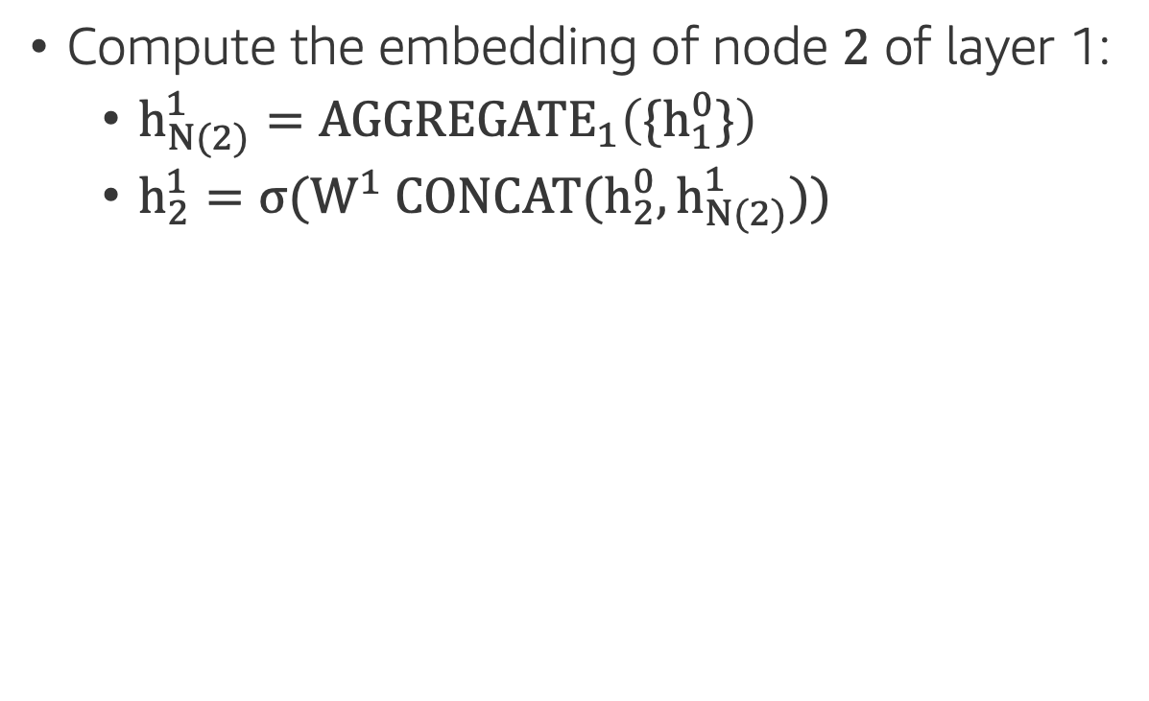
Two-layer GNN : A Node Perspective
Compute the embedding of node $2$ of layer 1:
$h_{N(2)}^{1}={AGGREGATE}_{1}\left(\{h_{1}^{0}\}\right)$
$h_{2}^{1}=σ(W^{1} CONCAT(h_{2}^{0},h_{N(2)}^{1}))$
2
3
1
10
5
9
4
6
8
7
11

Slide 24
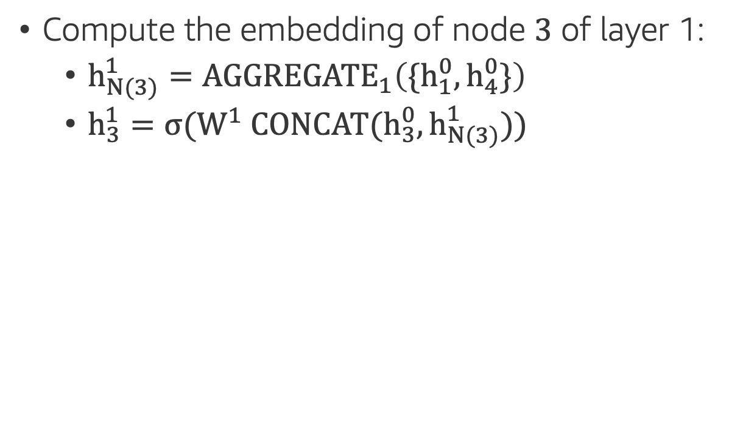
Two-layer GNN : A Node Perspective
Compute the embedding of node $3$ of layer 1:
$h_{N(3)}^{1}={AGGREGATE}_{1}\left(\{h_{1}^{0},h_{4}^{0}\}\right)$
$h_{3}^{1}=σ(W^{1} CONCAT(h_{3}^{0},h_{N(3)}^{1}))$
2
3
1
10
5
9
4
6
8
7
11

Slide 25
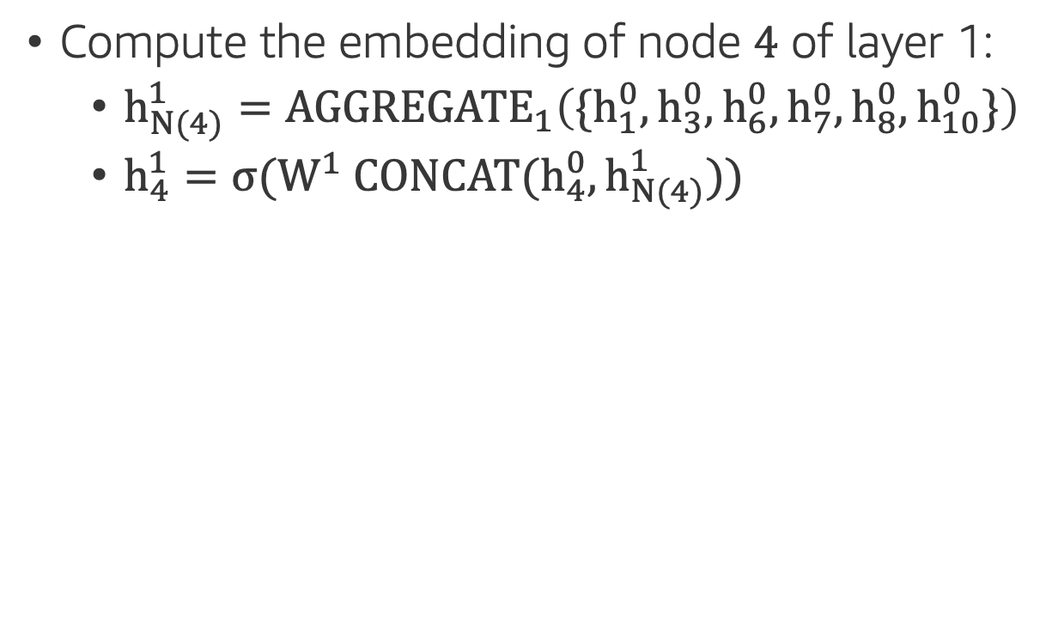
Two-layer GNN : A Node Perspective
Compute the embedding of node $4$ of layer 1:
$h_{N(4)}^{1}={AGGREGATE}_{1}\left(\{h_{1}^{0},h_{3}^{0},h_{6}^{0},h_{7}^{0},h_{8}^{0},h_{10}^{0}\}\right)$
$h_{4}^{1}=σ(W^{1} CONCAT(h_{4}^{0},h_{N(4)}^{1}))$
2
3
1
10
5
9
4
6
8
7
11

Slide 26

Two-layer GNN : A Node Perspective
Compute the embedding of node $5$ of layer 1:
$h_{N(5)}^{1}={AGGREGATE}_{1}\left(\{h_{1}^{0}, h_{9}^{0}\}\right)$
$h_{5}^{1}=σ(W^{1} CONCAT(h_{5}^{0},h_{N(5)}^{1}))$
2
3
1
10
5
9
4
6
8
7
11

Slide 27
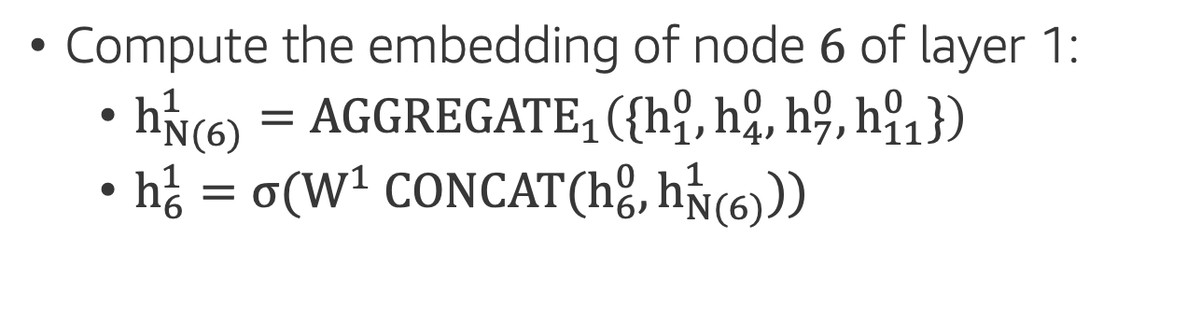
Two-layer GNN : A Node Perspective
Compute the embedding of node $6$ of layer 1:
$h_{N(6)}^{1}={AGGREGATE}_{1}\left(\{h_{1}^{0},h_{4}^{0},h_{7}^{0},h_{11}^{0}\}\right)$
$h_{6}^{1}=σ(W^{1} CONCAT(h_{6}^{0},h_{N(6)}^{1}))$
2
3
1
10
5
9
4
6
8
7
11

Slide 28
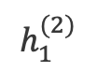
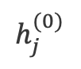
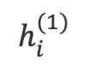
Computation / Data Dependency
To compute the result of one node we need a lot more other nodes.
$$h_{1}^{(2)}$$
1
$$h_{i}^{(1)}$$
2
3
4
5
6
$$h_{j}^{(0)}$$
1
3
4
6
7
8
9
10
11

Slide 29
Mini-Batch Generation on Graphs
Step 1: randomly sample target nodes.
Sample nodes for computing node embeddings.
Step 2: randomly sample neighbors
Equivalent to prune the computation/data dependency.

Slide 30
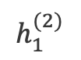
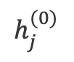
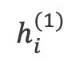
Too many nodes?
$$h_{1}^{(2)}$$
1
Neighborhood size increases exponentially with the number of layers.
$$h_{i}^{(1)}$$
2
3
4
5
6
$$h_{j}^{(0)}$$
1
3
4
6
7
8
9
10
11

Slide 31
Strategies of sampling neighbors
Neighborhood sampling (GraphSAGE)
Control-variate-based sampling (VRGCN)
Layer-wise sampling (FastGCN, LADIES)
Random-walk-based sampling (PinSage)
Subgraph sampling (ClusterGCN, GraphSAINT)
…
Notes:
We discussed only one of many strategies for sampling neighbors. There have been numerous papers recently showing the advantages of different sampling methods.
For the scope of this course we’ll not go into the details and just mention them here.

Slide 32
Neighborhood Sampling (GraphSAGE)
Always sample neighbors from a neighbor list of a vertex.
1
1
2
3
4
5
6
2
4
1
7
8
1
3
4
6
7
8
9
10
11

Slide 33
Mini-batch training in GNN models
2
3
1
1
GNN models
10
5
2
4
9
4
6
8
7
1
7
8
11
A mini-batch
The full graph

Slide 34
Heterogenous Graphs
Notes:
Add the sage maker icon

Slide 35
Heterogenous Graphs
Many real world networks are heterogenous
Drug-Protein Interactions
Knowledge Graphs
…
We want to adapt GNNs to these graphs to do the same tasks – edge prediction, node classification etc.
MATHEMATICS

Slide 36
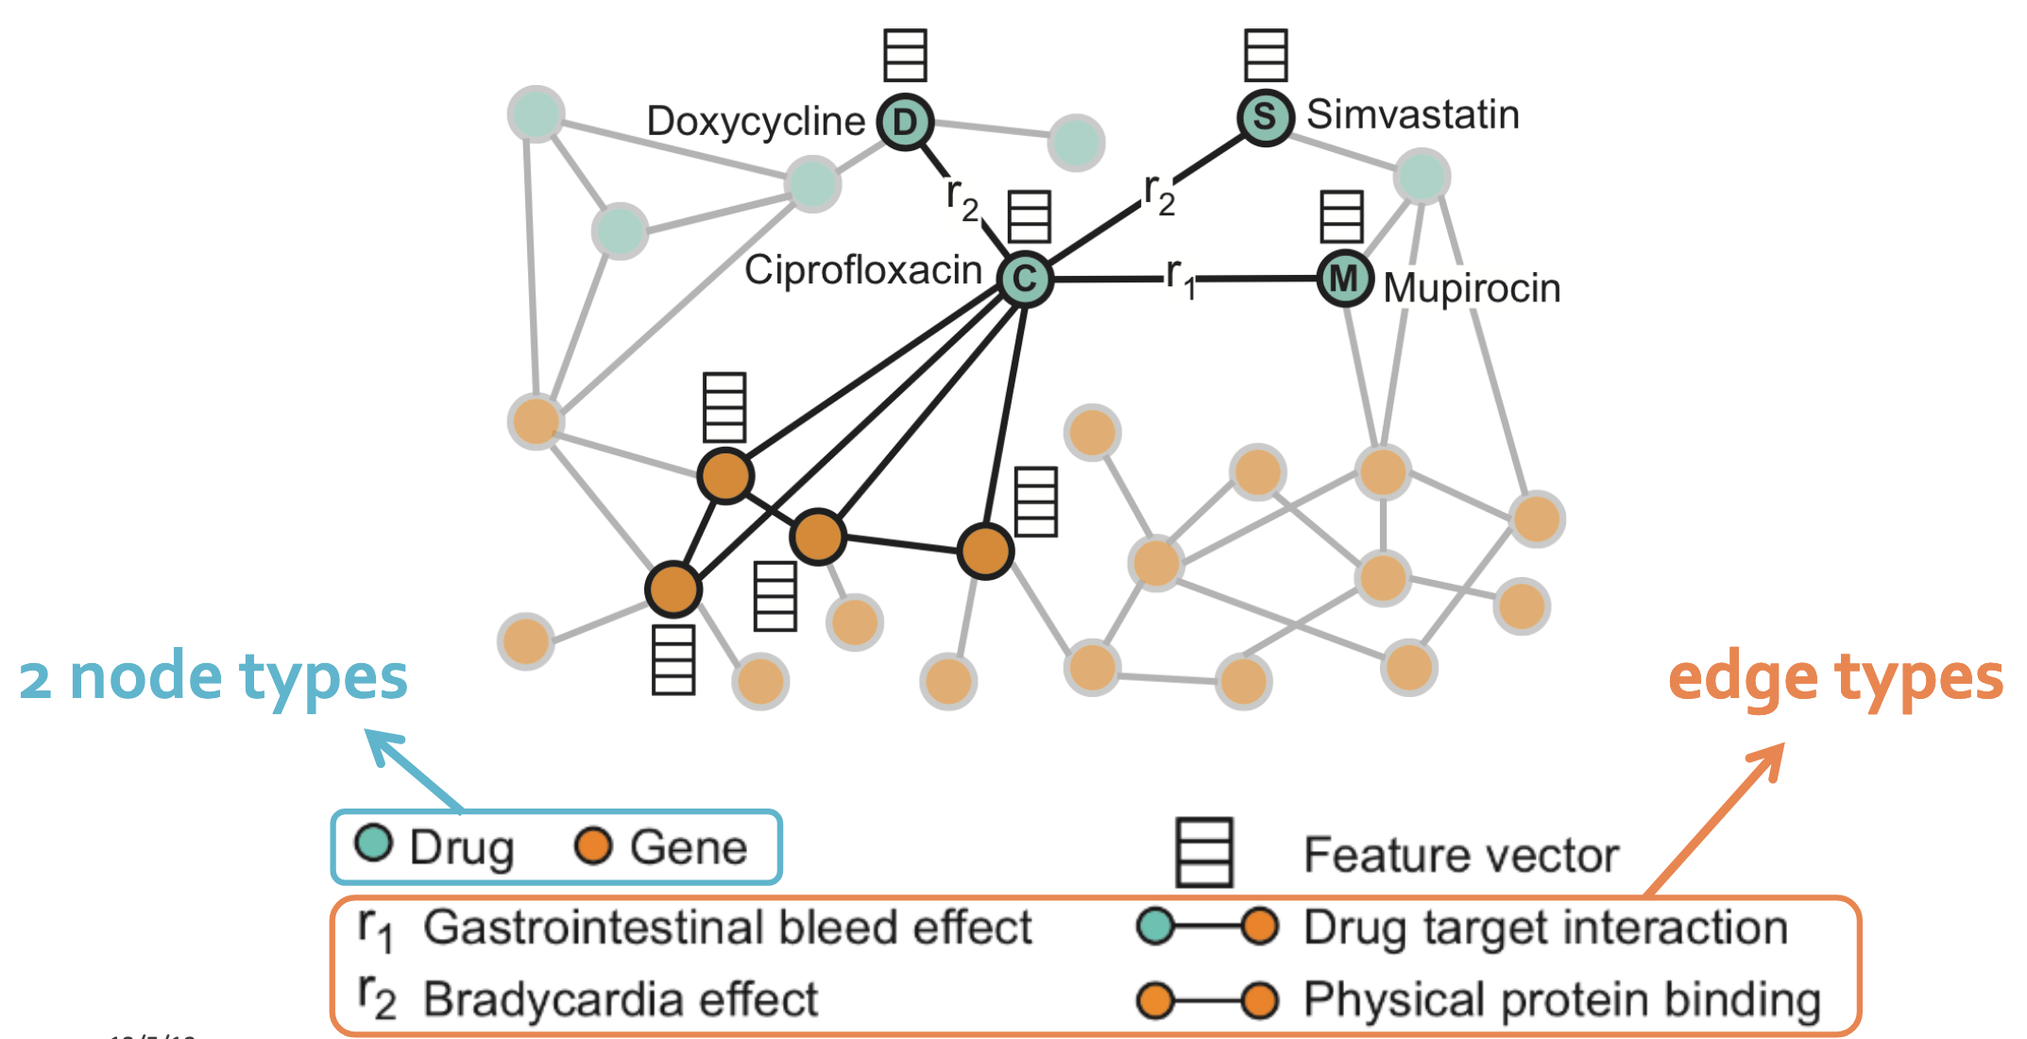
Heterogenous Graphs : Polypharmacy Example
MATHEMATICS

Slide 37
Heterogenous Graphs : Polypharmacy Example
Goal : Given the partially observed graph of drug-protein interactions, predict labeled edges of side-effect interactions between drug nodes
Key Idea : Compute GNN messages from each edge type and then aggregate across each edge type
MATHEMATICS

Slide 38
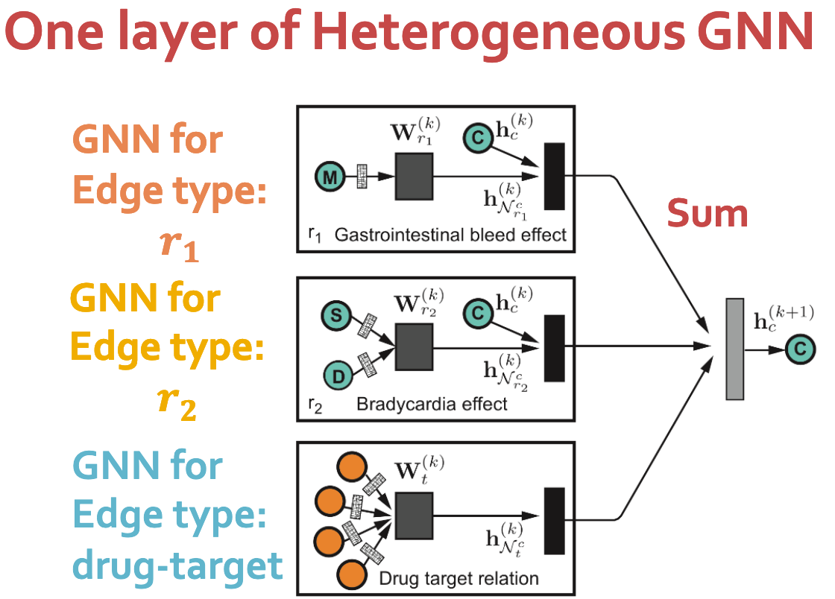
Heterogenous Graphs : Polypharmacy Example
MATHEMATICS

Slide 39
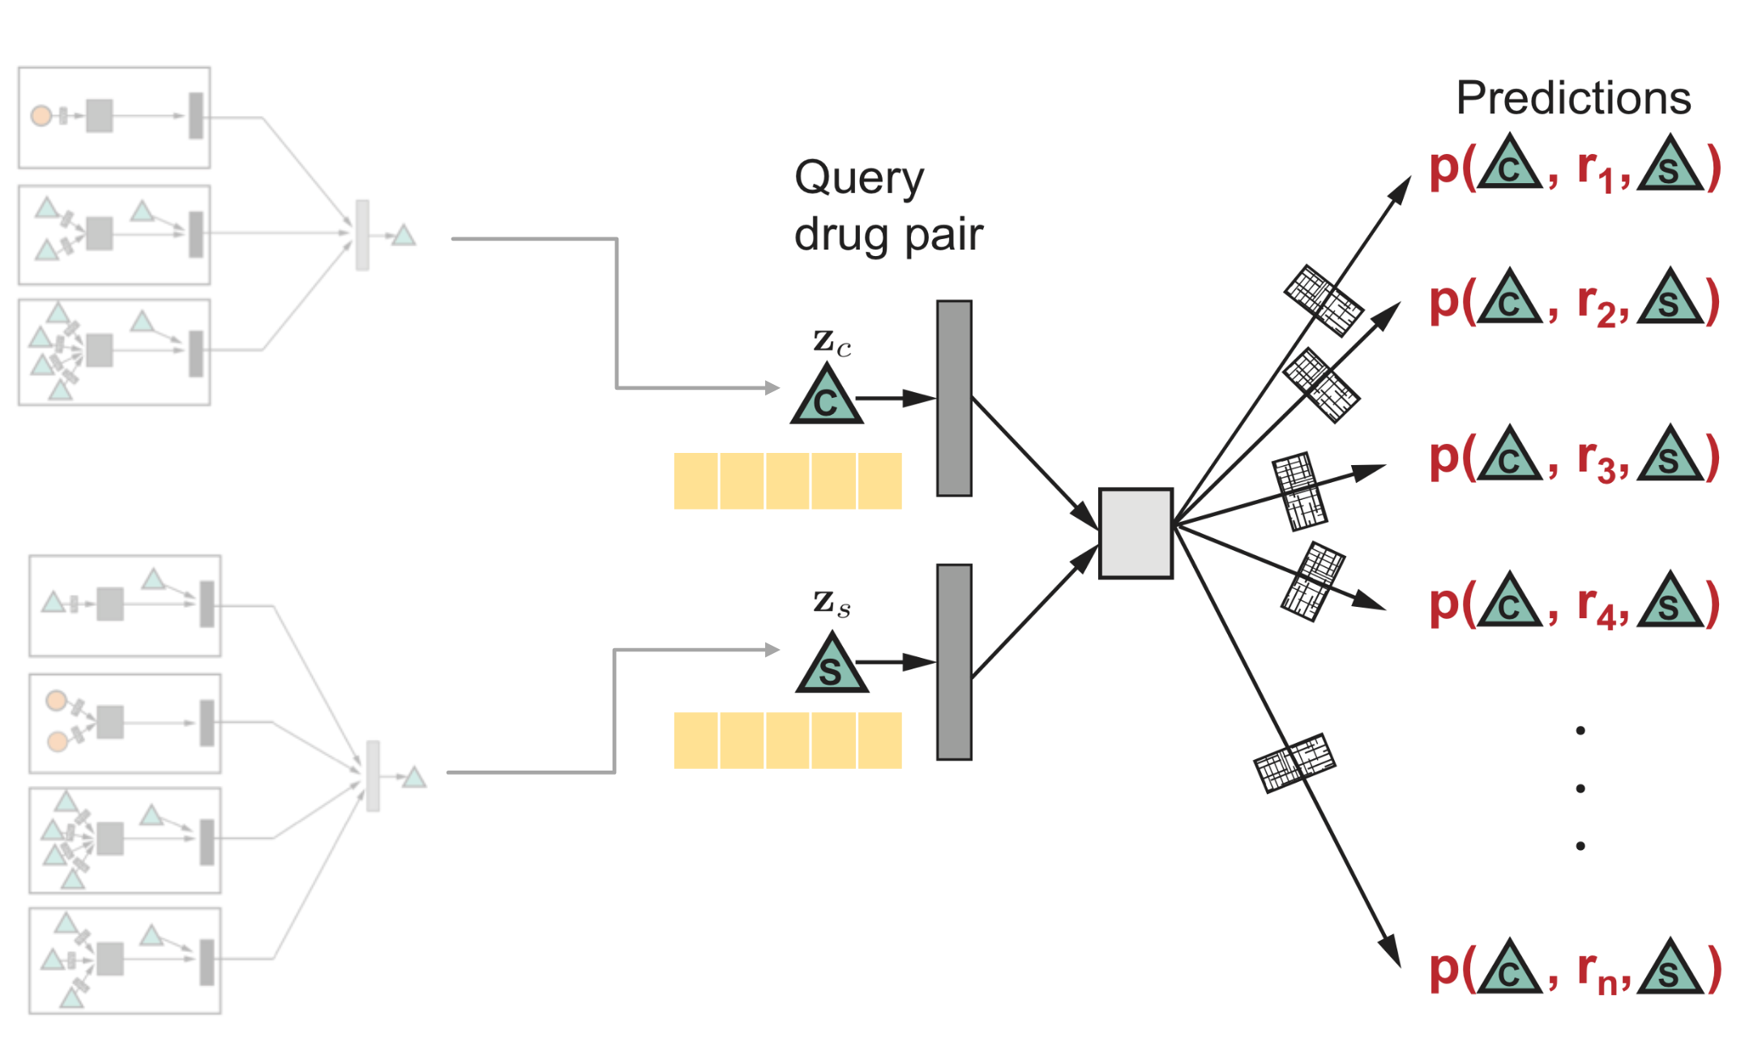
Heterogenous Graphs : Polypharmacy Link Prediction
MATHEMATICS

Slide 40
Case Study : Recommender Systems
Notes:
Add the sage maker icon

Slide 41
Recommender Systems
Problem Statement : Given a bipartite graph of users and products, recommend new products to users based on products they have already interacted with
MATHEMATICS

Slide 42
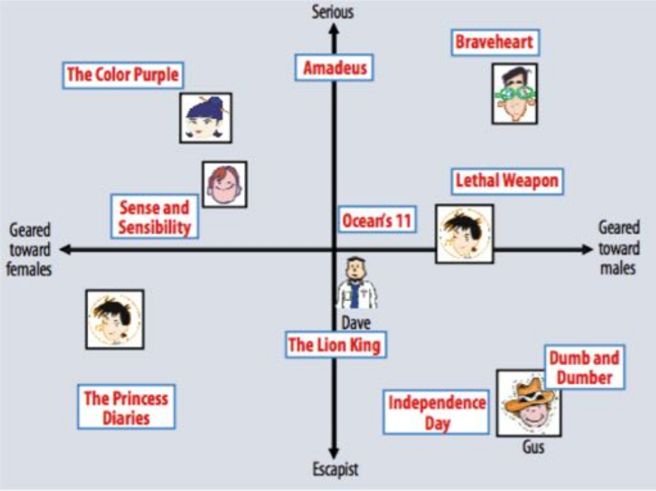
A Classical Approach : Collaborative Filtering
Represent movies and users as vectors in the same latent space
To recommend movies to a user, find new movies close to their embedding within the latent space

Slide 43

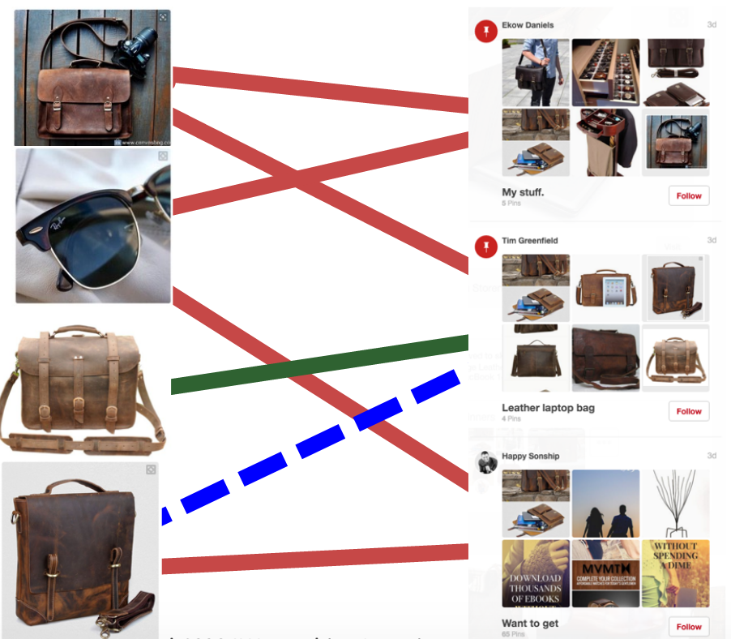
Formulation #1: User-to-Item Similarity
p₁
MATHEMATICS
b₁
p₂
b₂
p₃
b₃
p₄

Slide 44
Formulation #2 : Item-to-Item similarity
SOTA Recommender System based on GNNs
Pinterest : Human curated collection of pins
Pin : A visual bookmark from the web
Board : A collection of pins
Key Idea : Leverage superior embeddings that use structural information from the graph to provide better recommendations
MATHEMATICS

Slide 45
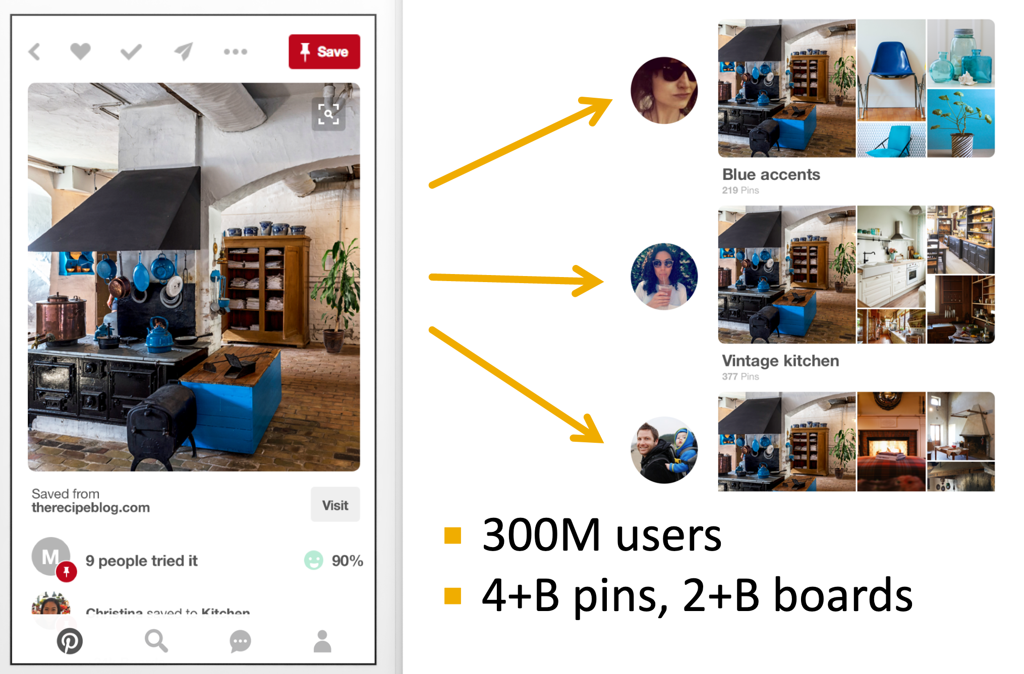
PinSAGE
MATHEMATICS

Slide 46
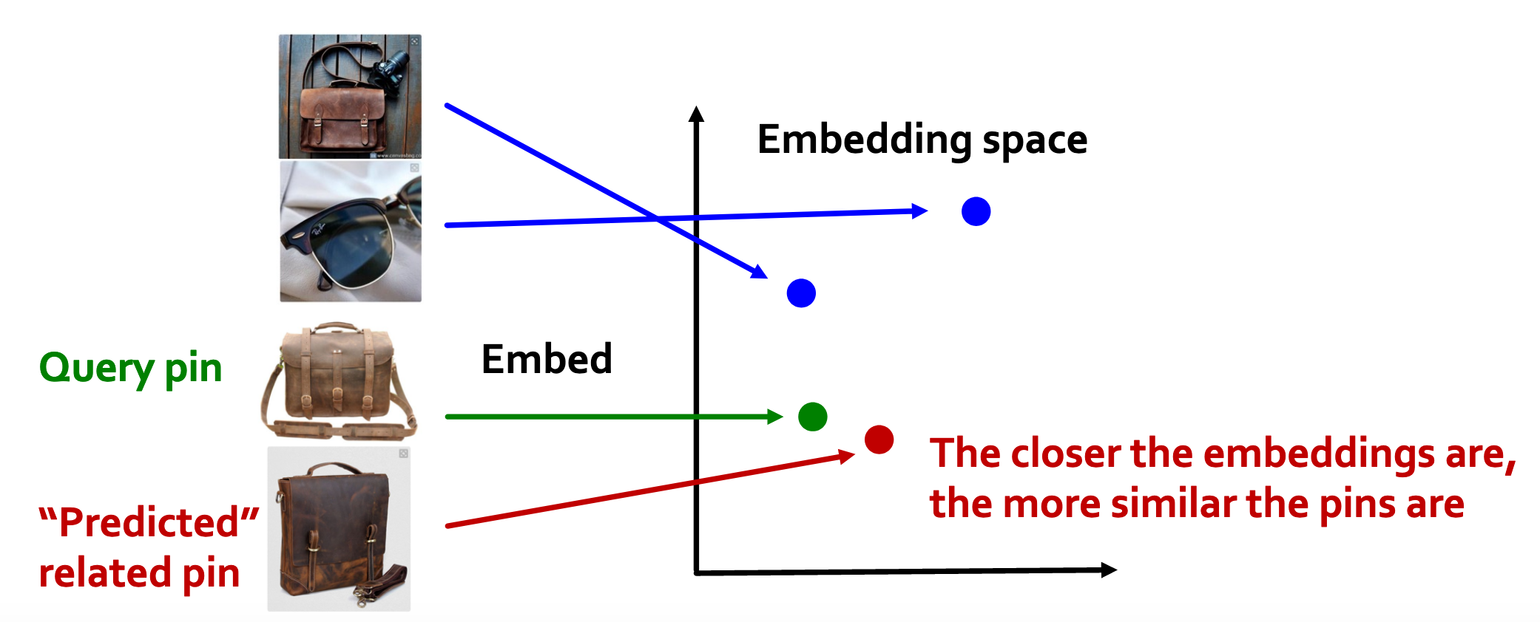
PinSAGE
MATHEMATICS

Slide 47
PinSAGE
Two sources of signal
Features : Image / text of each pin
Graph : Existing associations of pins to boards
Goal : Generate embeddings for each pin using a GNN scheme and recommend pins using nearest neighbor search
MATHEMATICS

Slide 48
PinSAGE
Unroll the computation graph for products on the underlying bipartite network, as described before
We do not consider this as a heterogenous graph to operate upon : the adjacent board nodes are treated as aggregators
MATHEMATICS

Slide 49
PinSAGE
Training pairs
Positive Pair : Pins that have been saved to the same board within a time window
Negative Pair : A random pair of 2 pins
Train the GNN to generate similar embeddings for positive pairs, dissimilar for negative pairs
MATHEMATICS

Slide 50
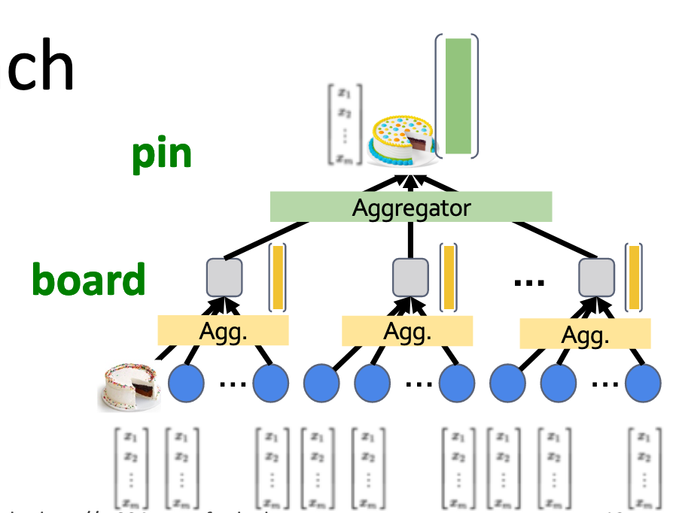
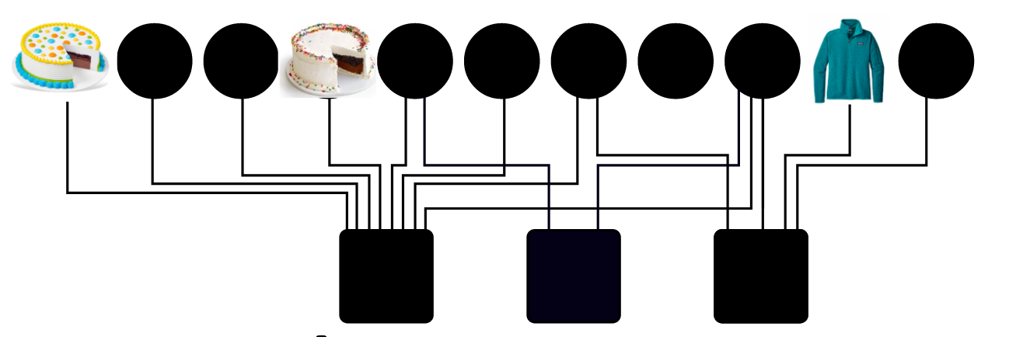
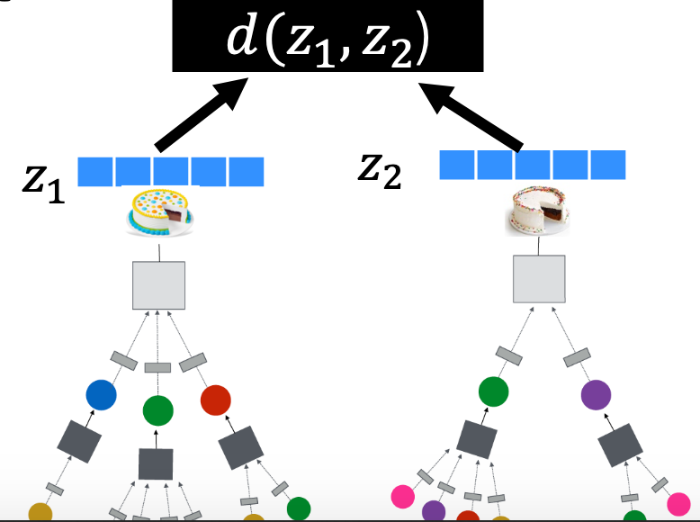
PinSAGE
MATHEMATICS

Slide 51
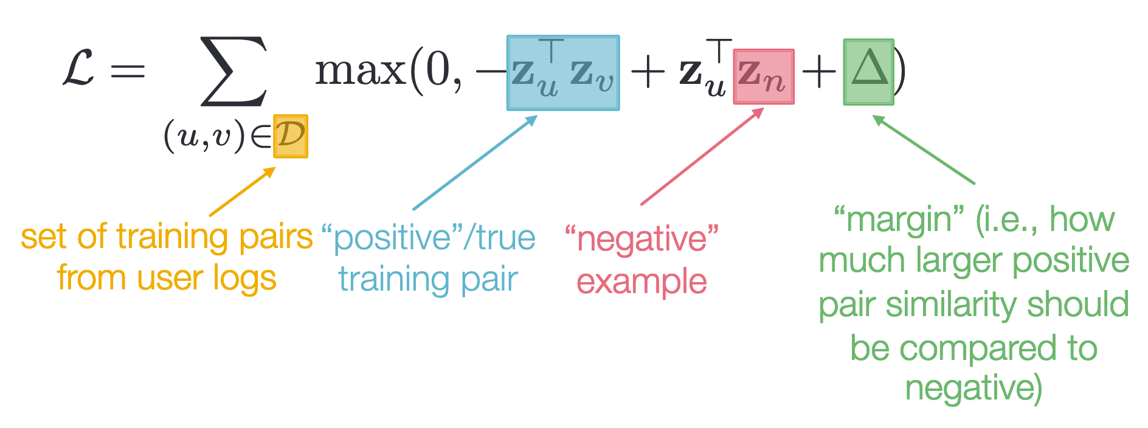
PinSAGE
Training : Positive pairs’ embeddings should be more similar than negative pairs
Max Margin Loss
MATHEMATICS

Slide 52
Final Project
Notes:
Add the sage maker icon

Slide 53
Final Project
Node classification on Amazon co-purchase graph using GNNs
Submit as many times as you like by Sunday 5pm - https://leaderboard.corp.amazon.com/tasks/703/
Upload *only* submission.csv that is generated for you
Notes:
We discussed only one of many strategies for sampling neighbors. There have been numerous papers recently showing the advantages of different sampling methods.
For the scope of this course we’ll not go into the details and just mention them here.

Slide 54
Summary

Slide 55
Conclusion
We introduce the basics of graph theory and machine learning while motivating the field with suitable examples.
We discuss different models developed for learning on graphs.
We talk about recent state of the field and popular GNN architectures
We implement walkthroughs using DGL framework.

